Slide 1
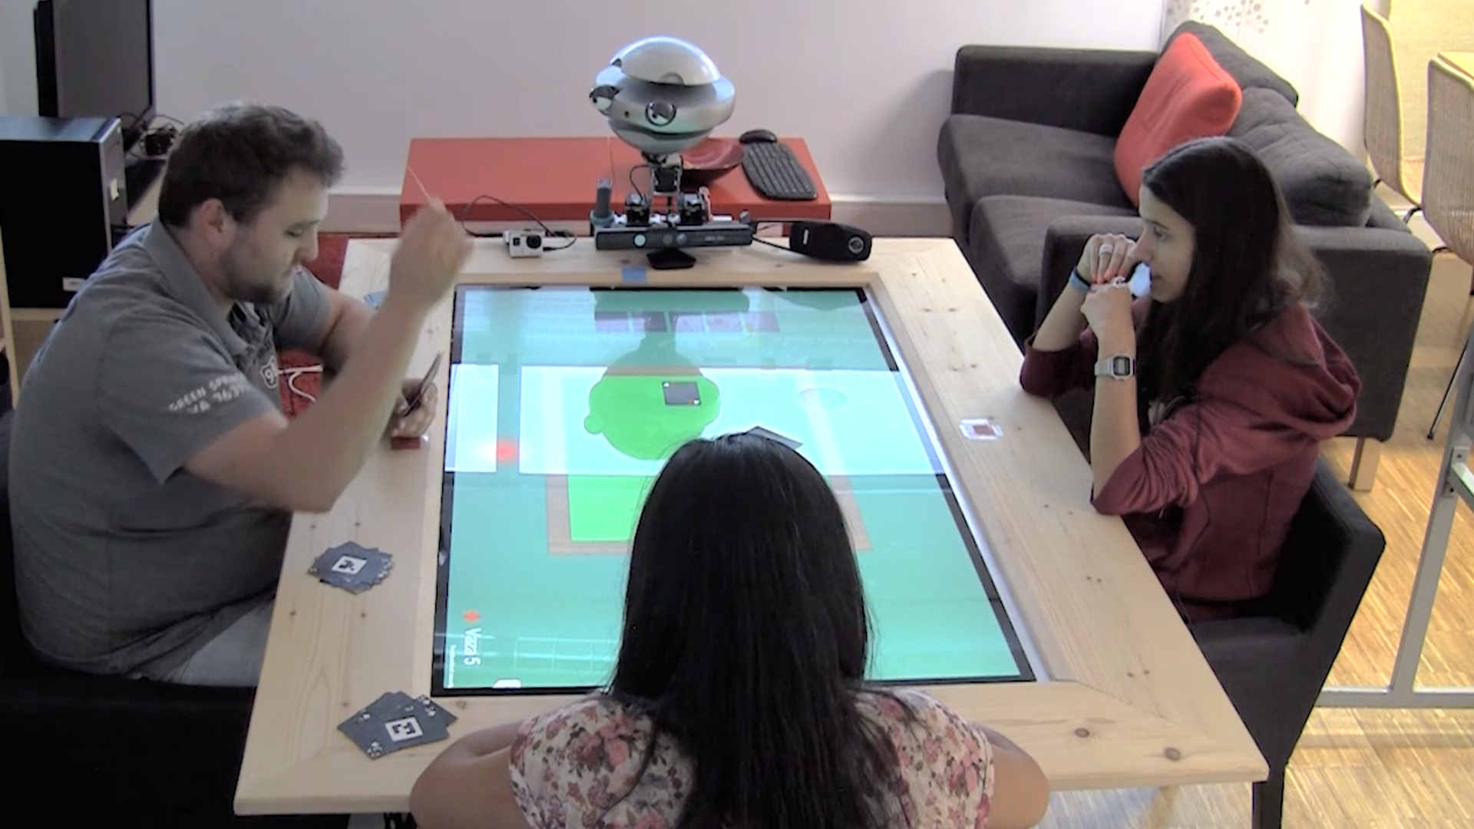
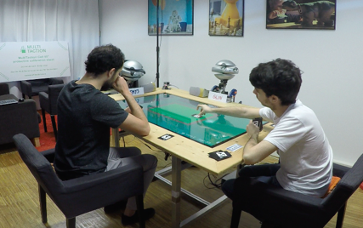
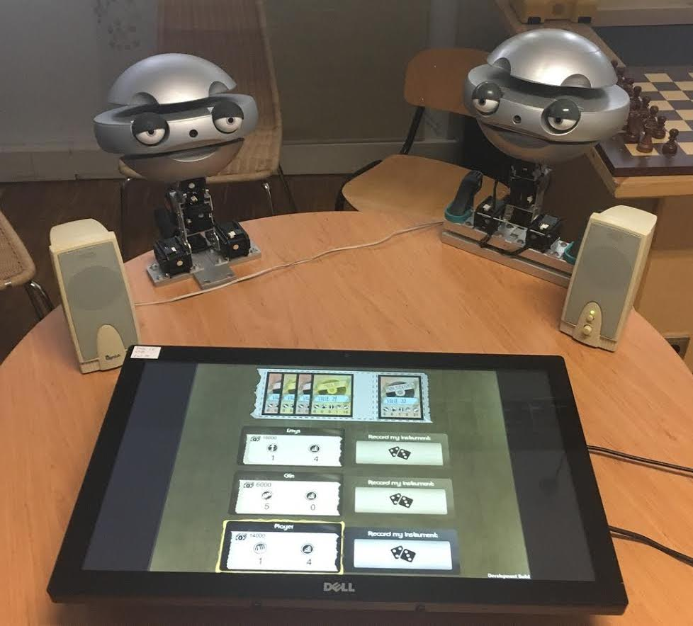






Group Intelligence on Social Robots
Filipa Correia, Francisco S. Melo, Ana Paiva
INESC-ID & University of Lisbon, Portugal
filipacorreia@tecnico.ulisboa.pt
Previous Work
Trust
Group Identity
Group Awareness
Group-based Emotions
Develop adaptive mechanisms for a social robot to improve group interaction
Team Formation
Group Intelligence
Emotional Expressions
Understand
group dynamics
in human-robot teams
Posture
Voice
Other?!
Predict group measures in real-time
Future Work
Behavioural Adaptation

